Slide 1

Narasaraopet Engineering College
(Autonomous)
Predictive analysis of bigmart sales using machine learning
Under the estimated guidance of
Mr.D.Venkat Reddy M.Tech.
Team members
B.Sriram (19471A0505)
Ch.Chandra Sekhar (19471A0508)
G.Jashuva (19471A0524)

Slide 2
ABSTRACT
Currently, supermarket run-centres, Big Marts keep track of each individual item's sales data in order to anticipate potential consumer demand and update inventory management.
Anomalies and general trends are often discovered by mining the data warehouse's data store. For retailers like Big Mart, the resulting data can be used to forecast future sales volume using various machine learning techniques like big mart.
A predictive model was developed using Xgboost, Linear regression, Polynomial regression, and Ridge regression techniques for forecasting the sales of a business such as Big -Mart, and it was discovered that the model outperforms existing models.

Slide 3
CONTENTS
Introduction
Existing system
Proposed system
Software and hardware requirements
Methodologies
Testing & Test Cases
Project Web pages
Conclusion
References

Slide 4
INTRODUCTION
Everyday competitiveness between various shopping centres as and as huge marts is becoming higher intense, violent just because of the quick development of global malls also online shopping.
Each market seeks to offer personalized and limited-time deals to attract many clients relying on period of time, so that each item's volume of sales may be estimated for the organization's stock control, transportation and logistical services.
The current machine learning algorithm is very advanced and provides methods for predicting or forecasting sales any kind of organization, extremely beneficial to overcome low – priced used for prediction. Always better prediction is helpful, both in developing and improving marketing strategies for the marketplace, which is also particularly helpful.

Slide 5
EXISTING SYSTEM
In existing system they used, Artificial neural organizations for nearby income estimations. It implements k-means algorithm. To develop a few deals of forecast standards regression, Auto regressive integrated moving average(ARIMA), Autoregressive moving average(ARMA) are used
Advantages:
1.It keep track of each item sales data in order to forecast implicit consumer demand and update force operation.
2.It aims to provide offers and limited time deals to attract numerous guests over time
Dis-advantages:
1.K-means algorithm produce less accurate scores in prediction.
2.ARIMA has poor performance for long term forecasts and It is computationally expensive

Slide 6
PROPOSED SYSTEM
The proposed system gives most effective analytics solution for sales forecasting which focuses on colourful algorithm operations to the dataset.
The system is more effective to handle massive datasets due to the inclusion of Ridge regression and linear regression models
Advantages:
1.The accurate result is available in the form of graph and pie chart for easy understanding.
2.It also helps retailer to get how to improve his sales and fulfill the demands of customer

Slide 7
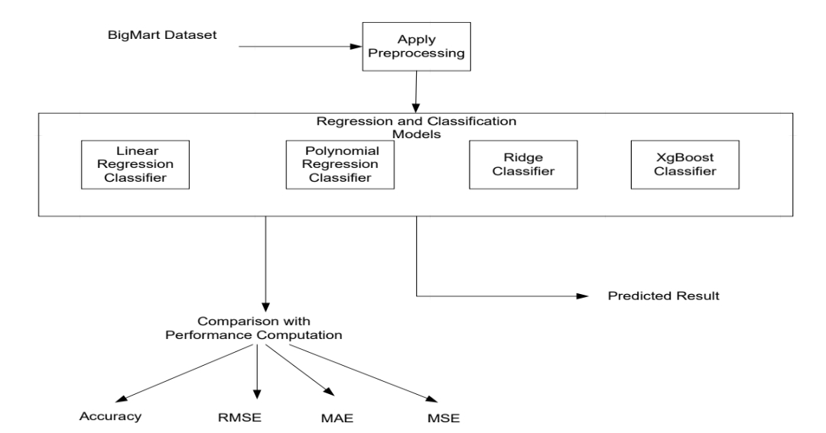
METHODOLOGIES

Slide 8
XGBoost Regression :
“Extreme Gradient Boosting” is same but much more effective to the gradient boosting system. It has both a linear model solver and a tree algorithm Which permits “xgboost” in any event multiple times quicker than current slope boosting executions.
It underpins various target capacities, including relapse, order and rating. As "xgboost" is extremely high in prescient force however generally delayed with organization, it is appropriate for some rivalries.
It likewise has extra usefulness for cross-approval and finding significant factors.

Slide 9
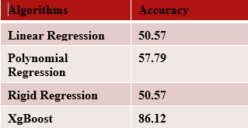
Result Analysis

Slide 10
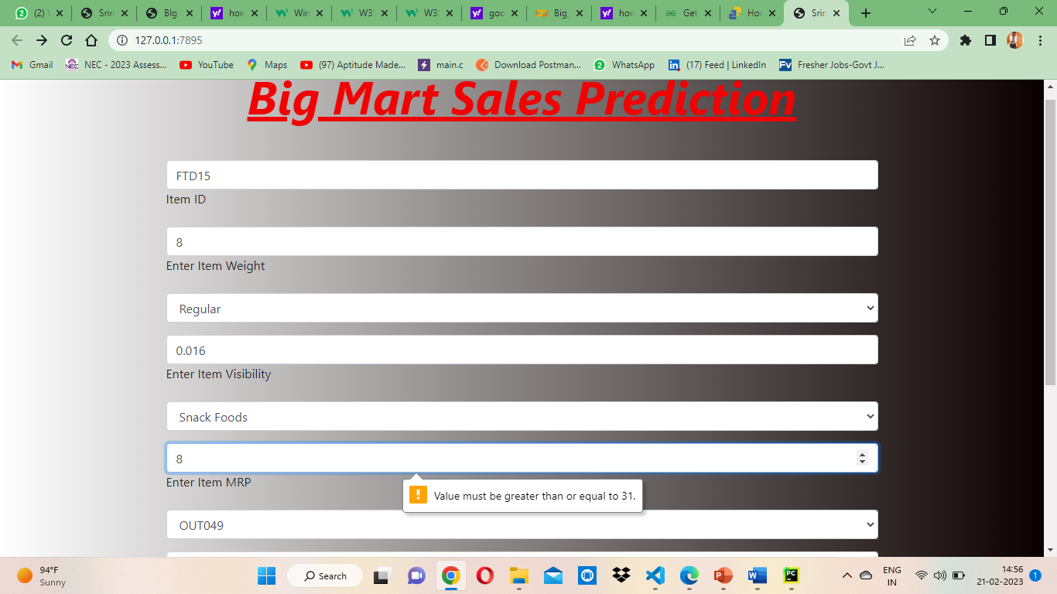
Test Cases
Test case1:

Slide 11
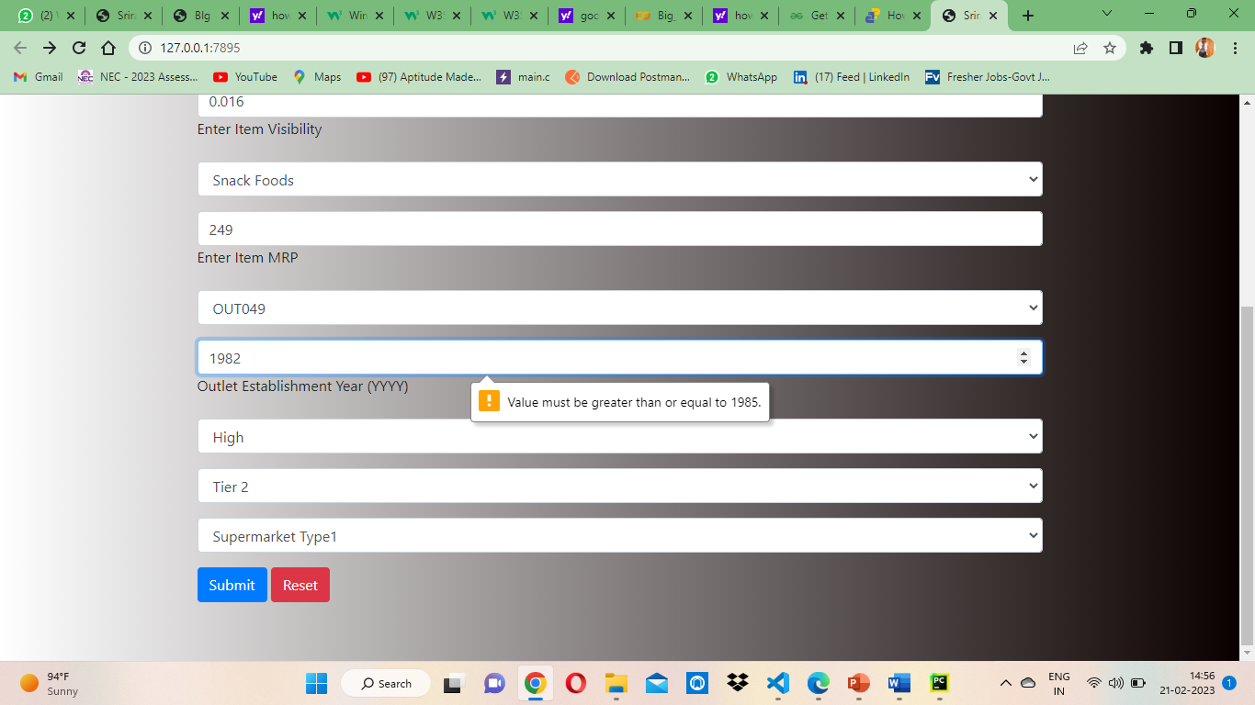
Test case2:

Slide 12
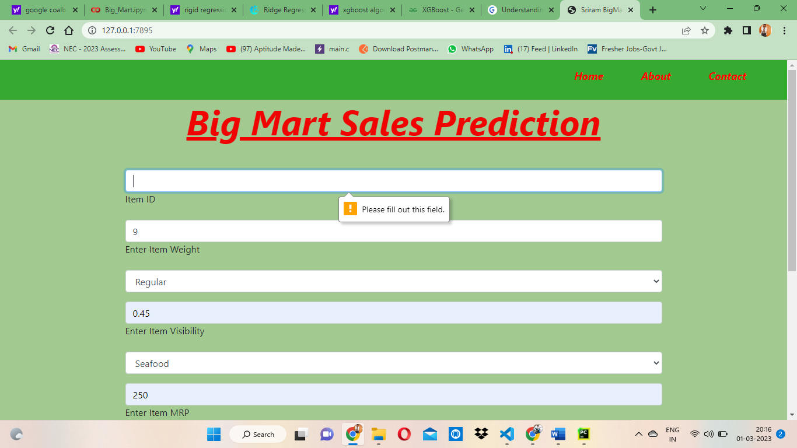
Project Screens

Slide 13
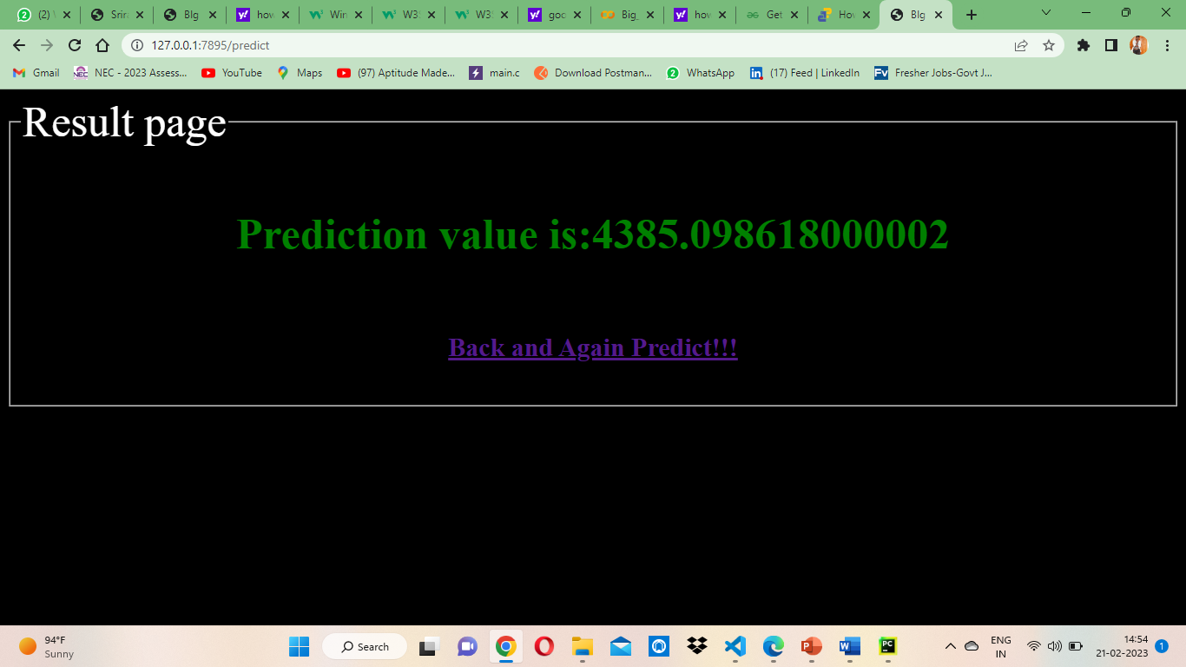

Slide 14
CONCLUSION
In this work, the effectiveness of various algorithms on the data on revenue and review of, best performance-algorithm, here propose a software to using regression approach for predicting the sales centered on sales data from the past the accuracy of linear regression prediction can be enhanced with this method, polynomial regression, Ridge regression, and Xgboost regression can be determined
So, we can conclude ridge and Xgboost regression gives the better prediction with respect to Accuracy, MAE and RMSE than the Linear and polynomial regression approaches.
In future, the forecasting sales and building a sales plan can help to avoid unforeseen cash flow and manage production, staff and financing needs more effectively
.
In future work we can also consider with the ARIMA model which shows the time series graph.

Slide 15
REFERNCES
Dataset Link : https://www.kaggle.com/paultimothymooney/Bigmart Sales - histopathology-images
Base Paper Link :
https://ieeexplore.ieee.org/document/9432109

Slide 16
THANK U

